Slide 1
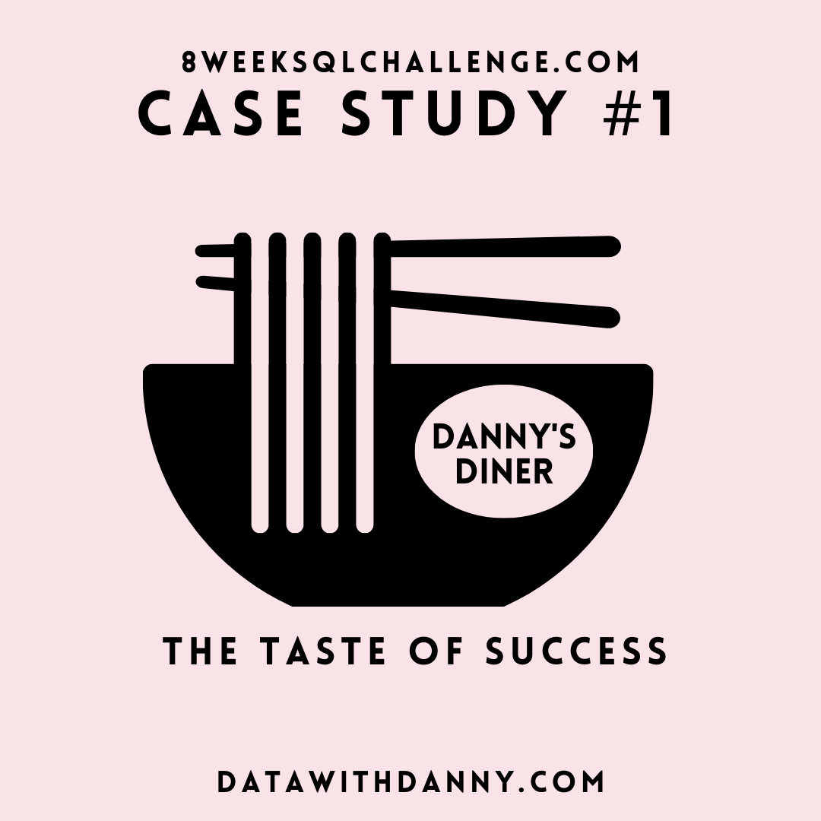

Slide 2
INTRODUCTION
Danny, a big fan of Japanese food, took a bold step at the start of 2021 by opening a charming restaurant called Danny's Diner. His restaurant specializes in serving three of his all-time favorite dishes: sushi, curry, and ramen.
However, despite their enthusiasm, Danny and his team are facing challenges in leveraging the data they have collected over the initial months of operation. They are seeking assistance to understand how to effectively utilize their data in order to ensure the success and sustainability of their business.

Slide 3
PROBLEM STATEMENT
Danny seeks your assistance as a data analyst to extract meaningful insights from the available datasets. He recognizes that you have the expertise to help him answer key questions about his customers, such as their visit patterns, expenditure, and preferred menu items. By leveraging your analytical skills, he hopes to gain a deeper understanding of his customers and use that knowledge to enhance their dining experience.
In addition to helping him uncover valuable insights, Danny wants your guidance in evaluating the potential expansion of the customer loyalty program. He relies on your expertise to analyze the data and provide recommendations based on the findings.
Furthermore, Danny requests for my support in generating basic datasets that his team can easily explore and analyze without relying on complex SQL queries. As a data analyst, my role is crucial in helping Danny make data-driven decisions and optimize the operations of his restaurant.

Slide 4
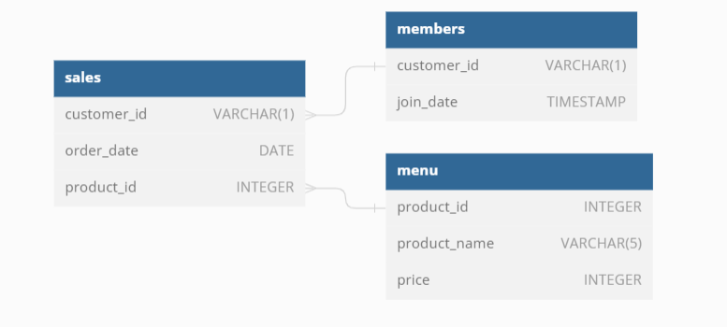
Entity Relationship Diagram

Slide 5
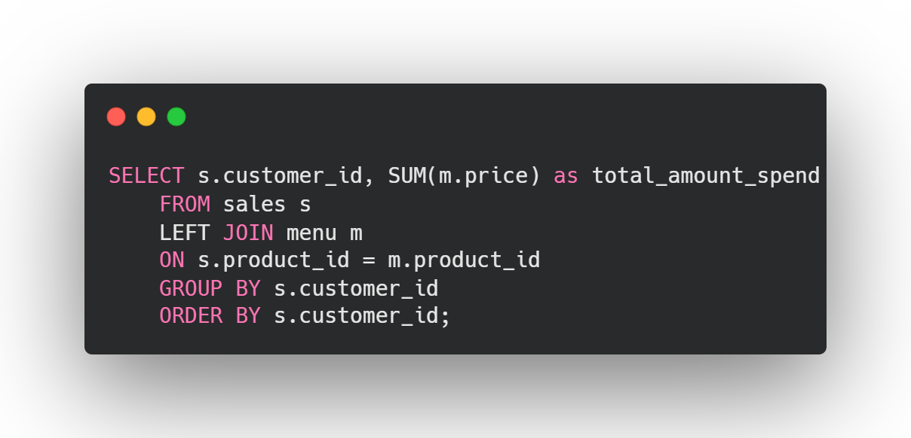
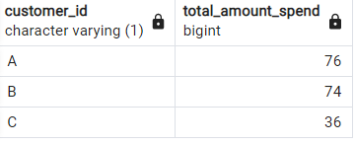
Question 1: What is the total amount each customer spent at the restaurant?
Answer:
Insight :
Customer A has spent $76, the most in the restaurant.
Customer B is following closely in second spending $74
Customer C has spent $36, the least amount.
Result:

Slide 6
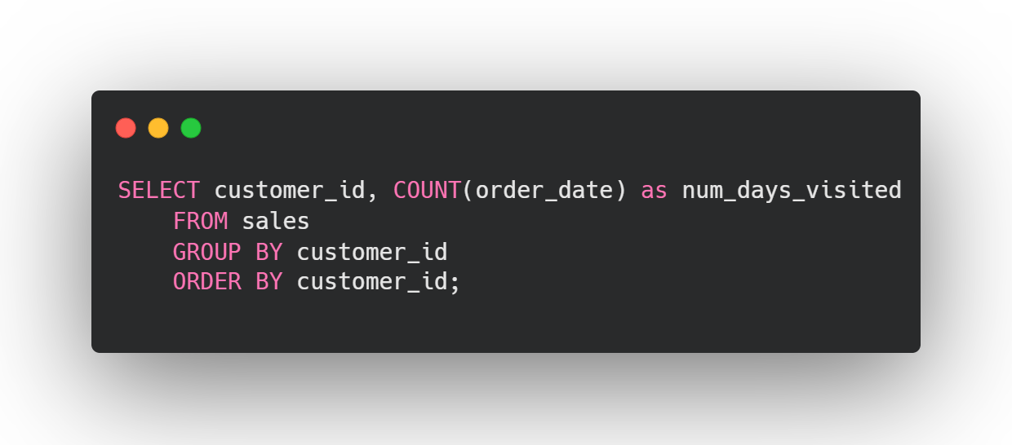
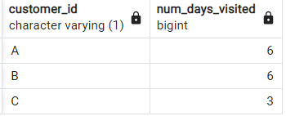
Question 2: How many days has each customer visited the restaurant?
Answer:
Insight :
Both Customer A and Customer B have visited the restaurant 6 times, which is the most.
Customer C has visited 3 times, which is the least.
Result:

Slide 7
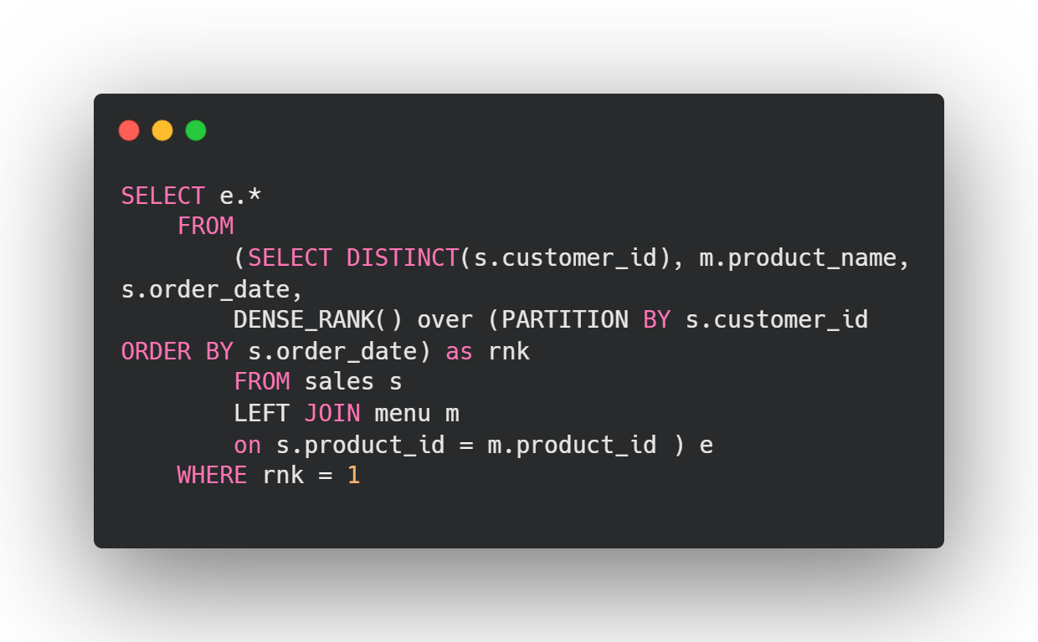
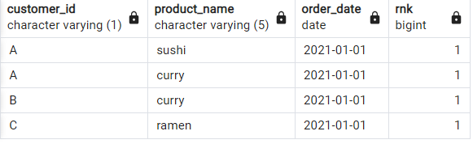
Question 3: What was the first item from the menu purchased by each customer?
Answer:
Insight :
The first purchased were…
Customer A was sushi and curry.
Customer B was curry.
Customer C was ramen.
Result:

Slide 8
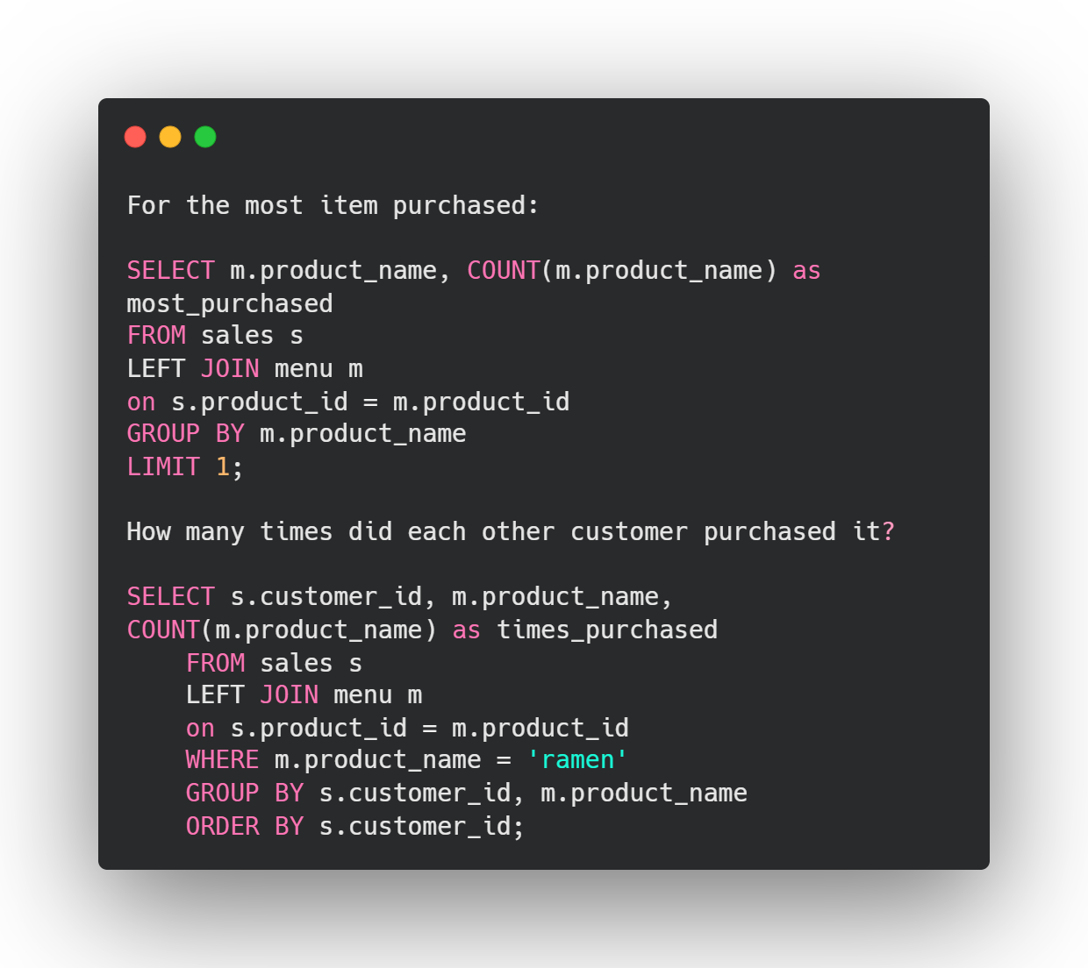

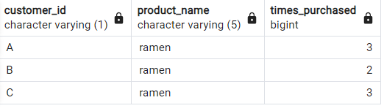
Question 4: What is the most purchased item on the menu and how many times was it purchased by all customers?
Answer:
Insight:
Ramen is the most purchased item.
Customer A and B has purchased it 3 times.
Customer C has only purchased ramen twice.
Results:

Slide 9
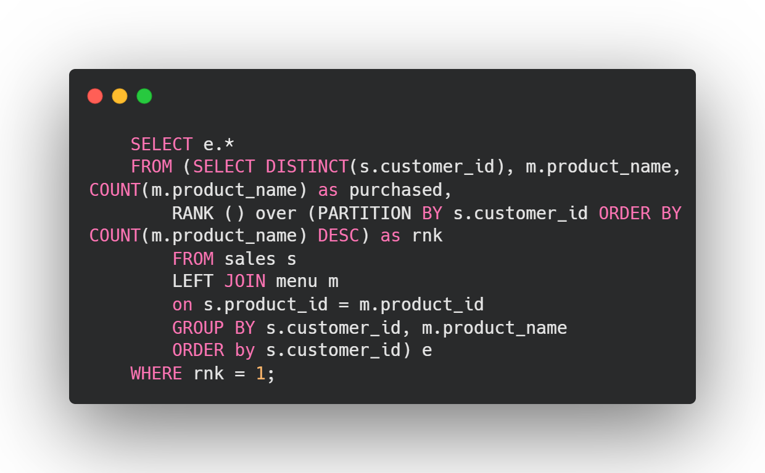
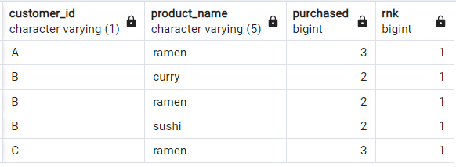
Question 5: Which item was the most popular for each customer?
Answer:
Insight :
Customer A most popular item is ramen.
Customer B most popular items are curry, ramen and sushi.
Customer c most popular item is ramen.
Results:

Slide 10
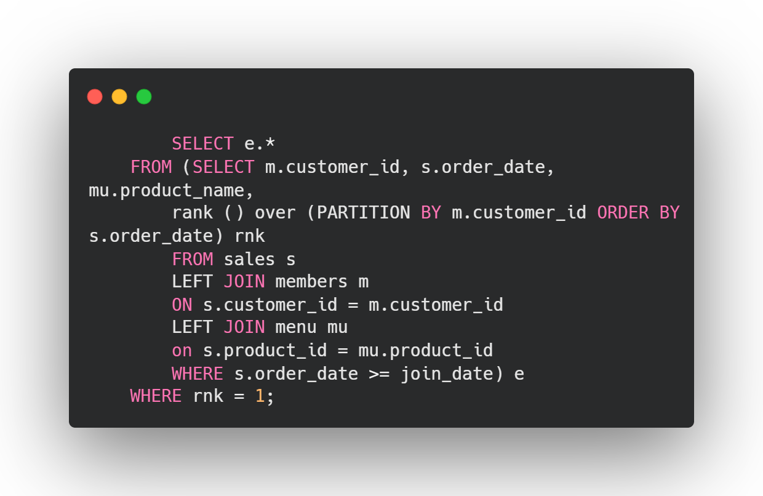
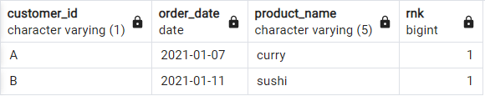
Question 6: Which item was purchased first by the customer after they became a member?
Answer:
Insight :
Customer A first purchased as a member was curry.
Customer B first purchased as a member was sushi.
Results:

Slide 11
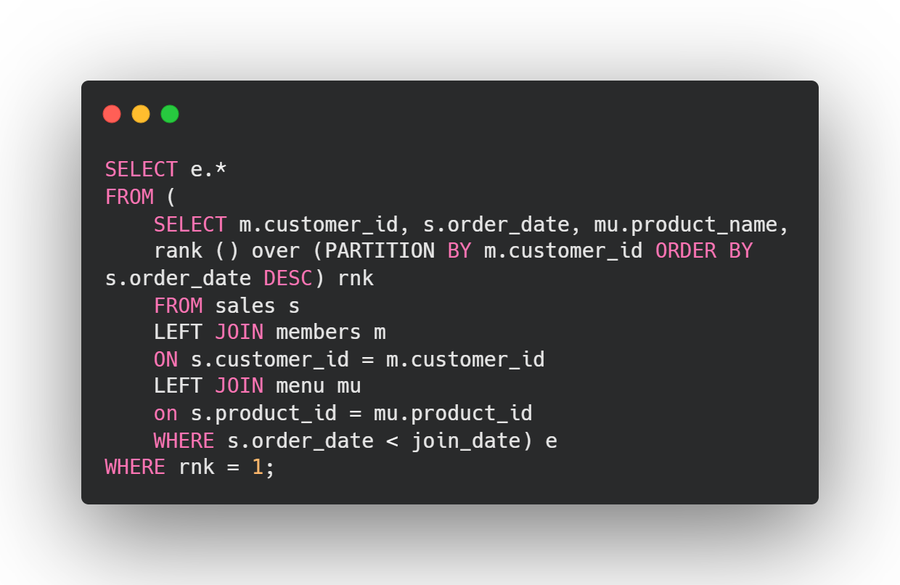
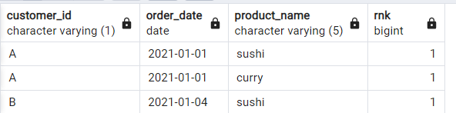
Question 7: Which item was purchased just before the customer became a member?
Answer:
Insight :
Customer A purchased sushi and curry before becoming a member.
Customer B purchased sushi before becoming a member.
Results:

Slide 12
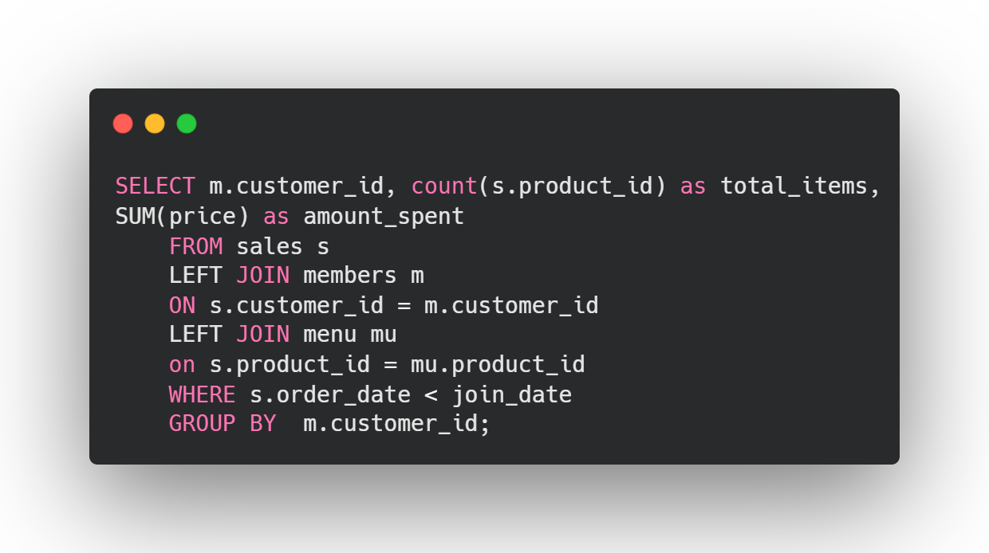
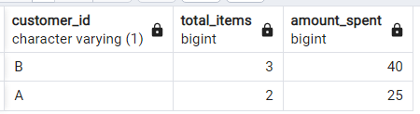
Question 8: What is the total items and amount spent for each member before they became a member?
Answer:
Insight :
Customer B spent $40 on 3 items before becoming a member.
Customer A spent $25 on 2 items before becoming a member.
Results:

Slide 13
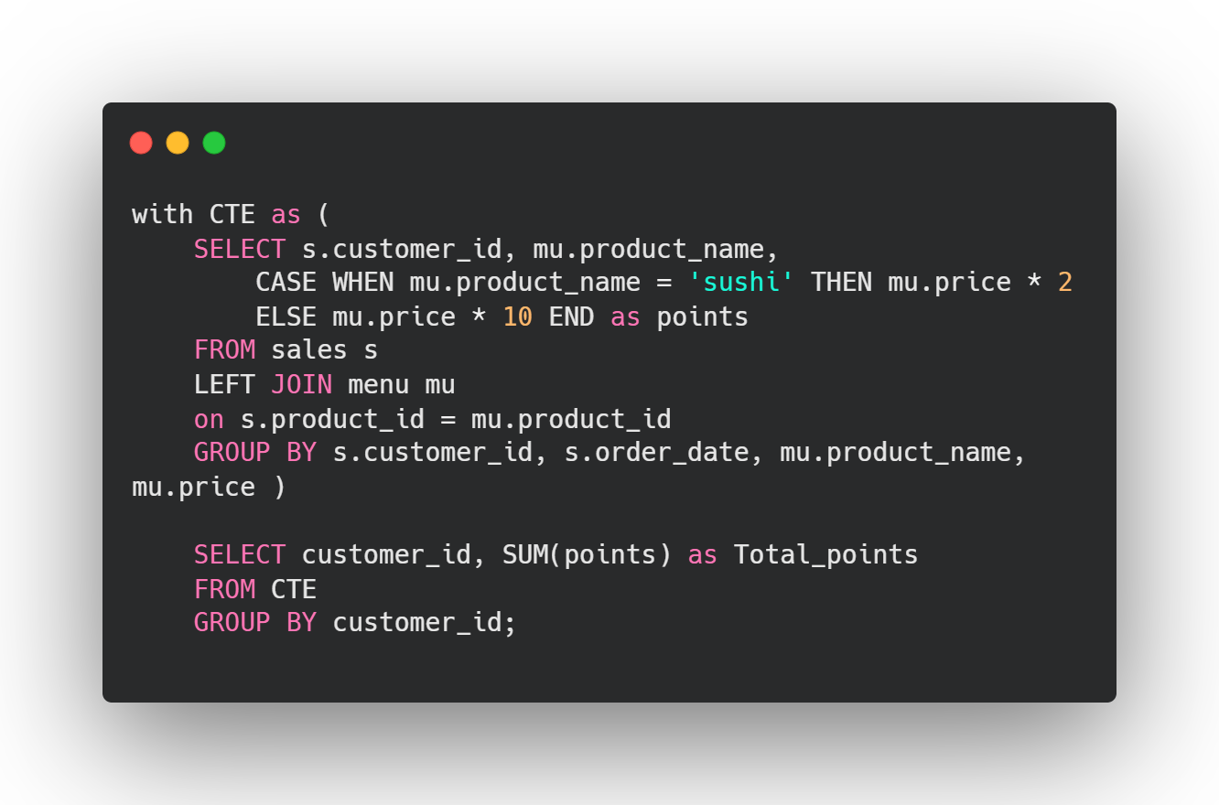
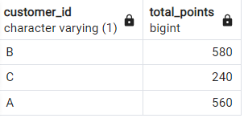
Question 9: If each $1 spent equates to 10 points and sushi has a 2x points multiplier - how many points would each customer have?
Answer:
Insight :
With these considerations,
Customer B has 580 points, which is the most point.
Followed by Customer A with 560 points.
Lastly, Customer C has 240 points, which is the least.
Results:

Slide 14
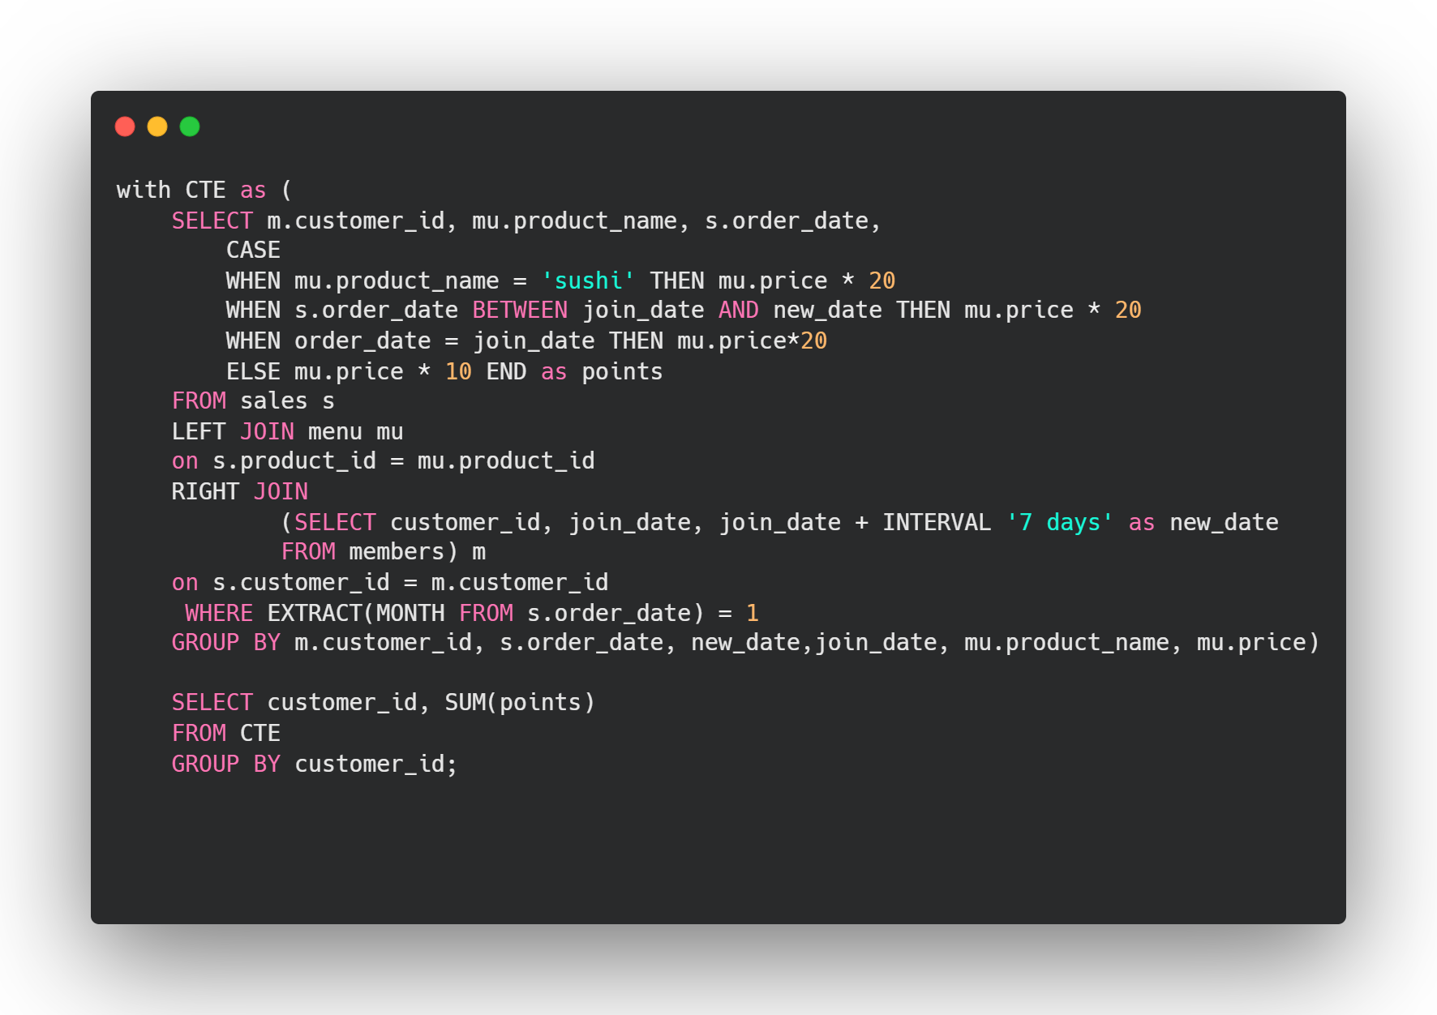
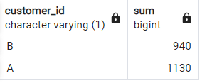
Question 10: In the first week after a customer joins the program (including their join date) they earn 2x points on all items, not just sushi - how many points do customer A and B have at the end of January?
Answer:
Insight :
With these consideration,
Customer A will have 1130 points.
Customer B will have 940 points.
Results:

Slide 15
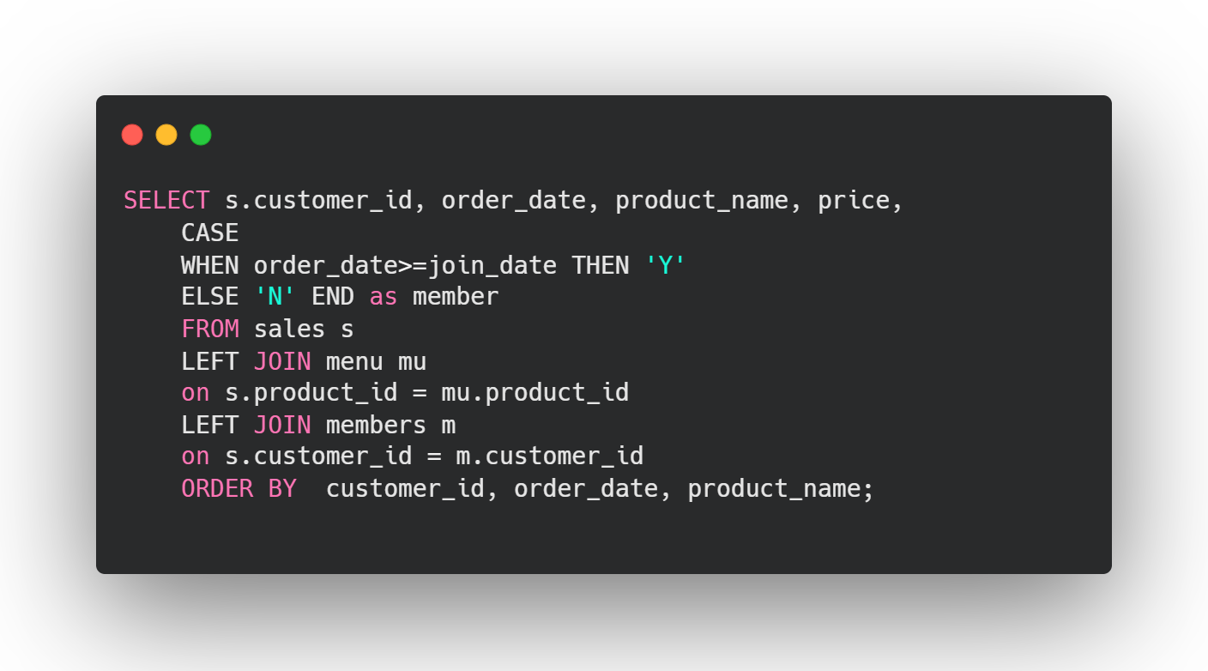
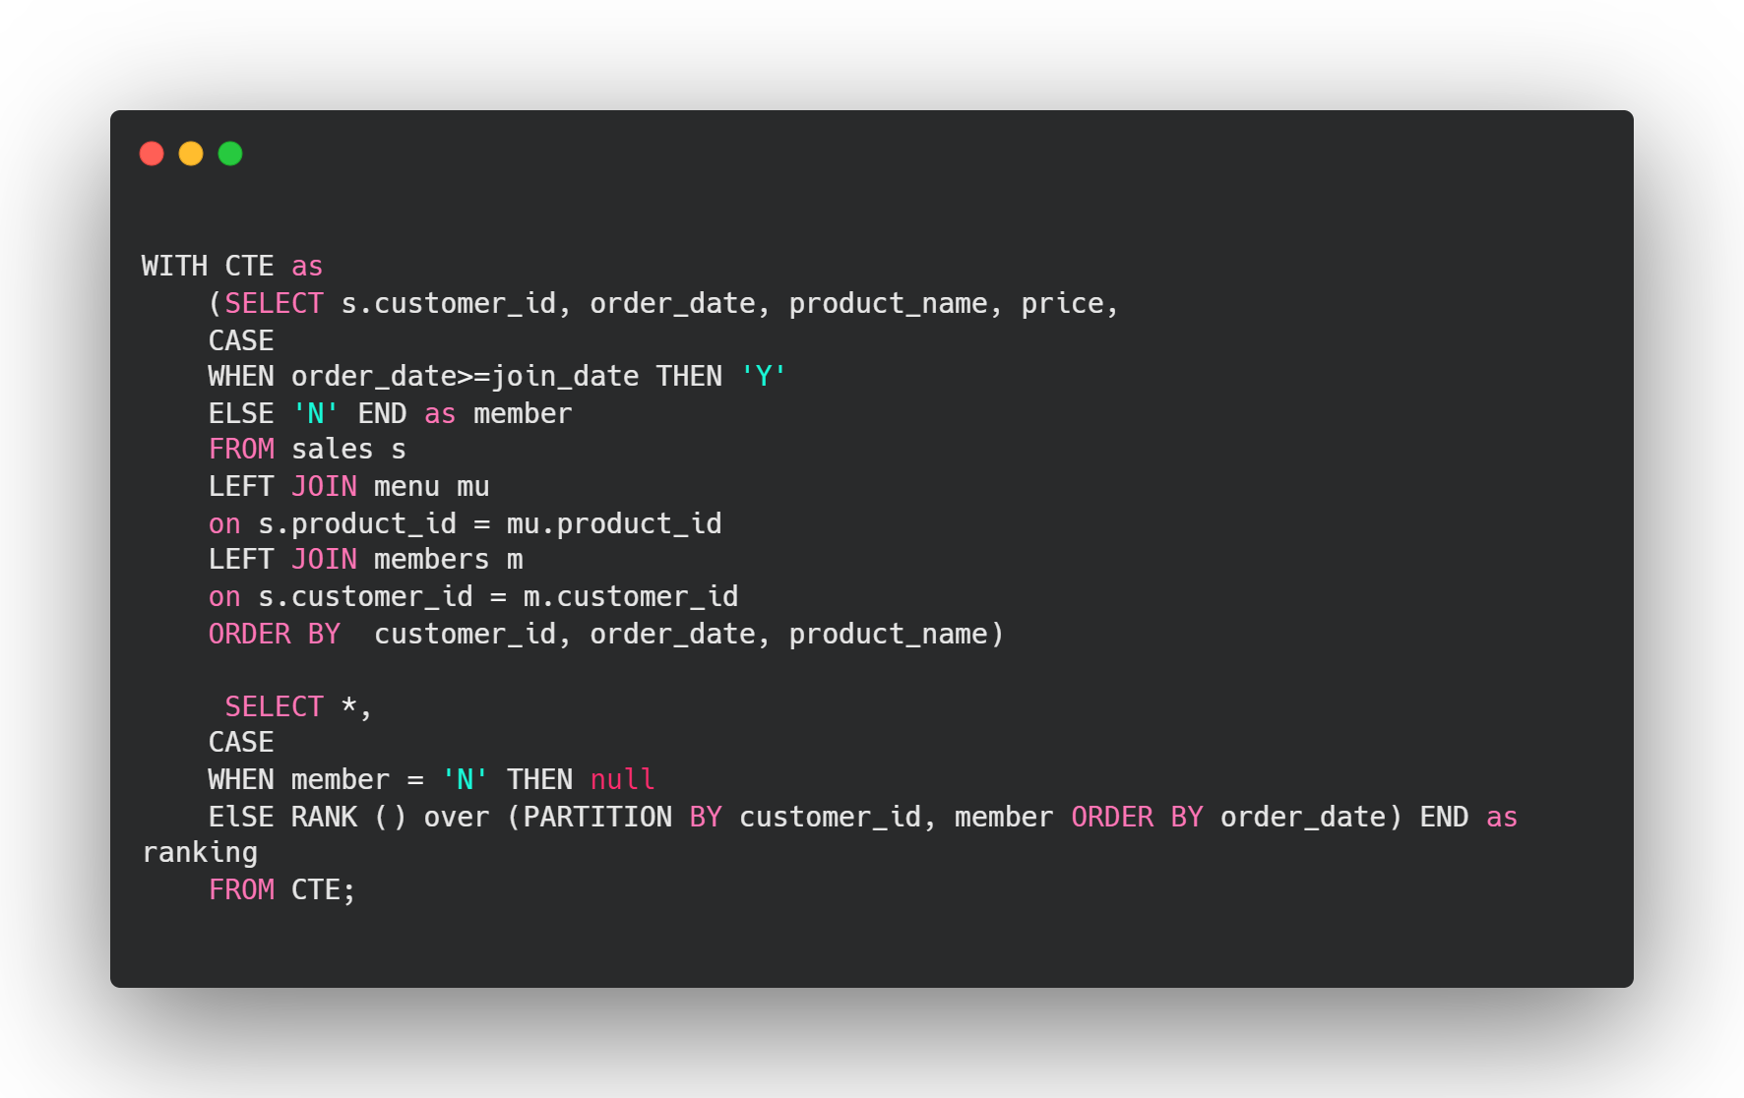
BONUS QUESTIONS
Danny also requires further information about the ranking of customer products, but he purposely does not need the ranking for non-member purchases so he expects null ranking values for the records when customers are not yet part of the loyalty program.
Recreate the table

